Slide 1
EY
Data Challenge 1
Dominik Benk

Slide 2
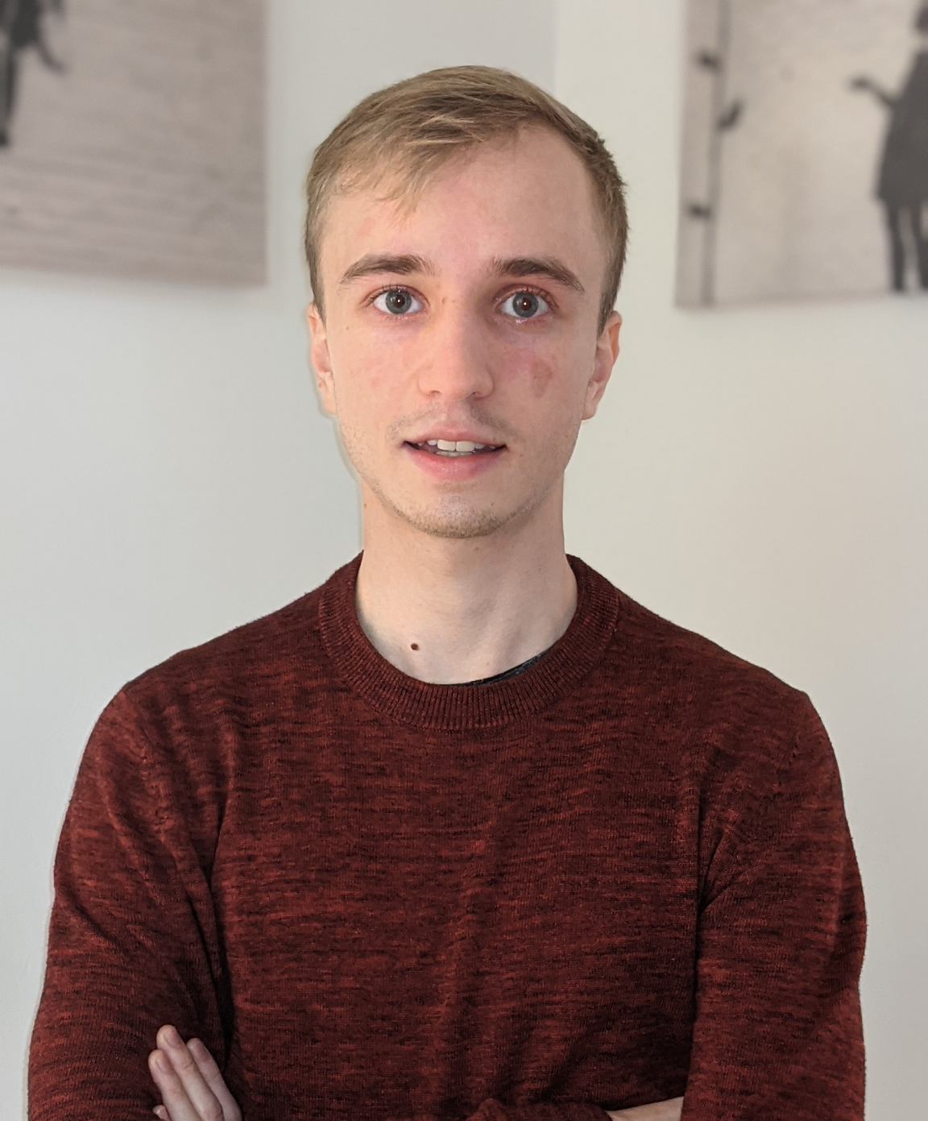
About myself
Dominik Benk
FSV IES UK

Slide 3
Outline
01
02
03
04
DATA PREPARATION
TRAINING AND EVALUATION
PREDICTIONS AND RESULTS
DISCUSSION

Slide 4
Preparing the data
35 + 3
Matching scan labels with composite polygons and other polygons based on comments
New polygons matched
32 / 129
Selecting subset of the most reasonable scan-polygon pairings
Linescans selected
3 412
Generating the data for training
Patches generated
Notes:
Based on visual inspection

Slide 5

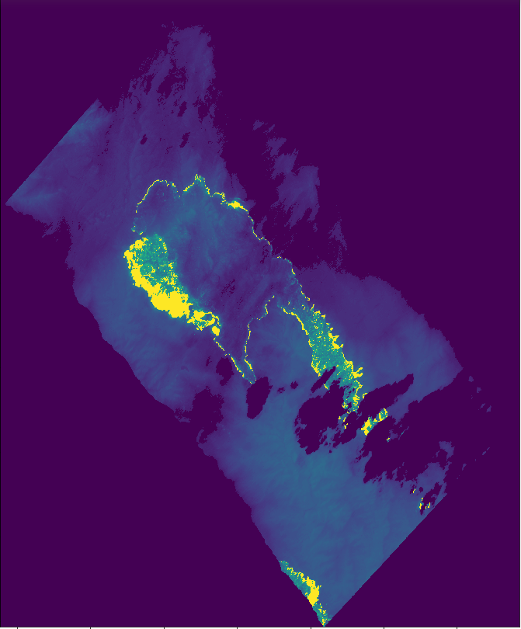
Generating patches
Masks
Images
1% to 90%
>75%
Fire pixels
Nonzero pixels
512
512
stride

Slide 6
Training a model
Splitting train and development data
Random data augmentation
Defining model and setting hyperparameters
Evaluating IoU on development data
Training best model with full data
Notes:
20%
aby se dev neprekryval s train

Slide 7
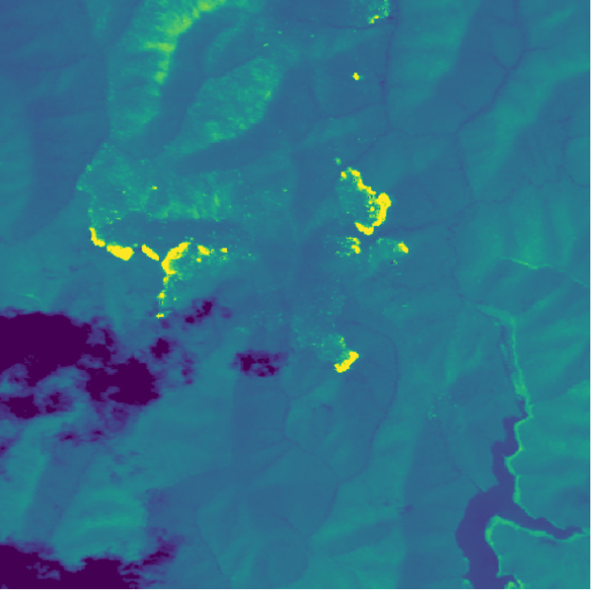
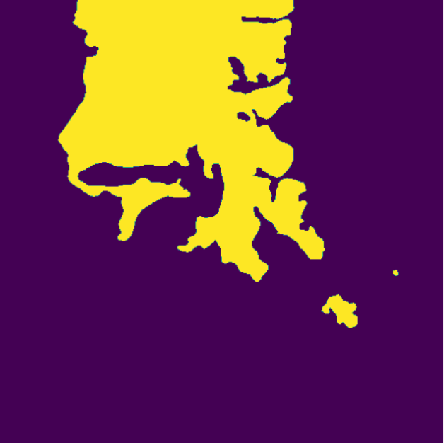
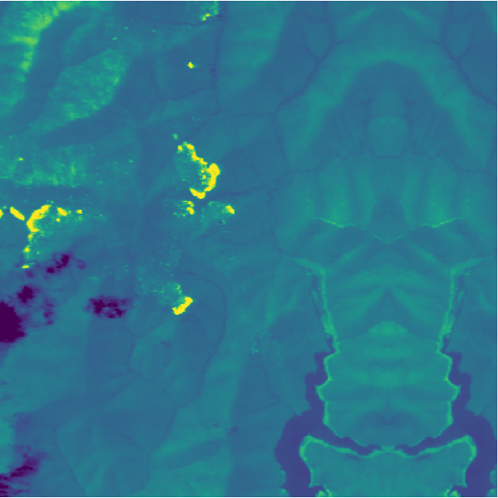
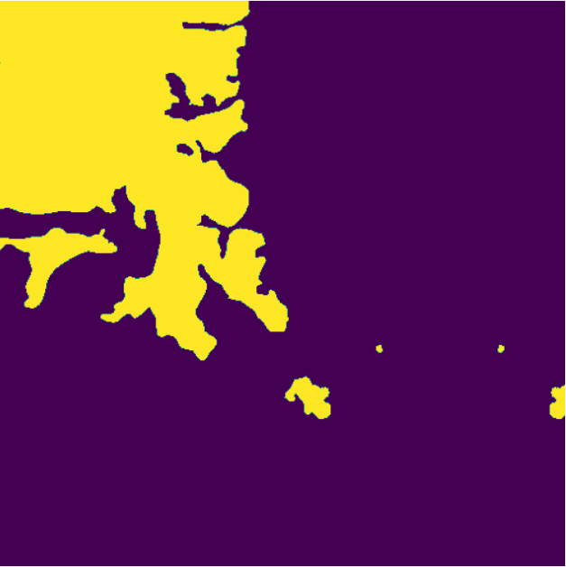
Random data augmentation
H+W Shift
Reflection
Notes:
Unique data, regularization

Slide 8
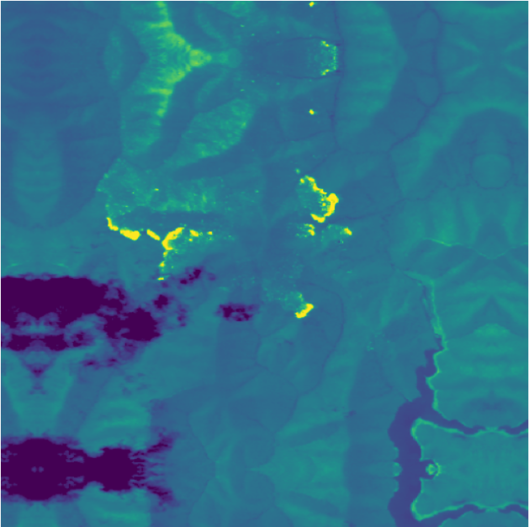

Random data augmentation
Zoom
Notes:
Unique data, regularization

Slide 9
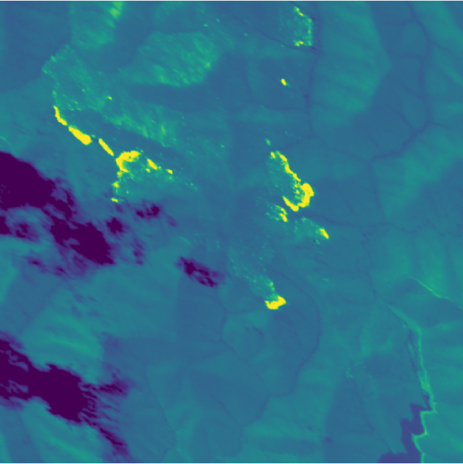
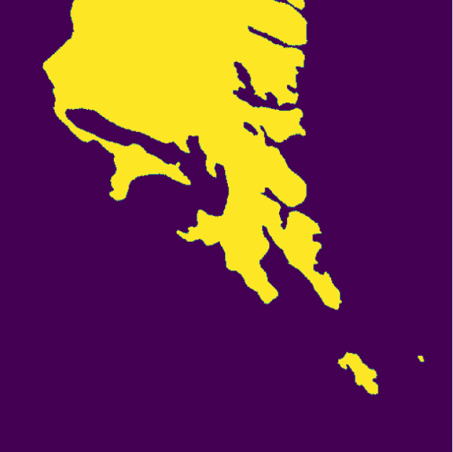
Random data augmentation
Shear
Notes:
Unique data, regularization

Slide 10
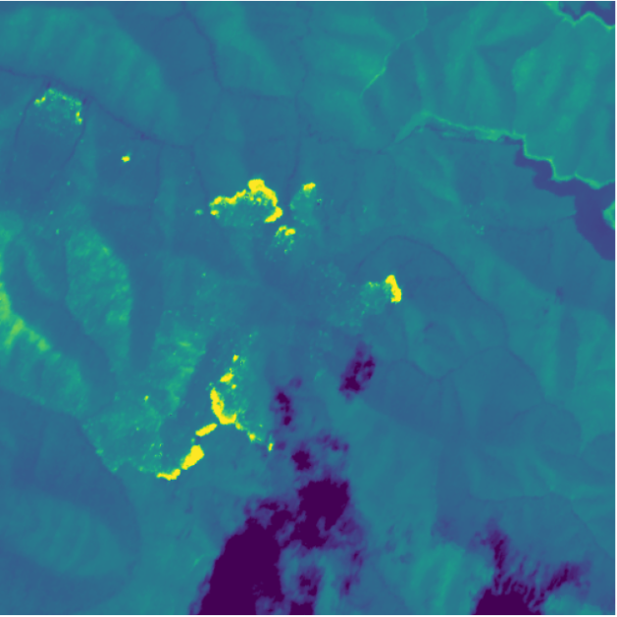
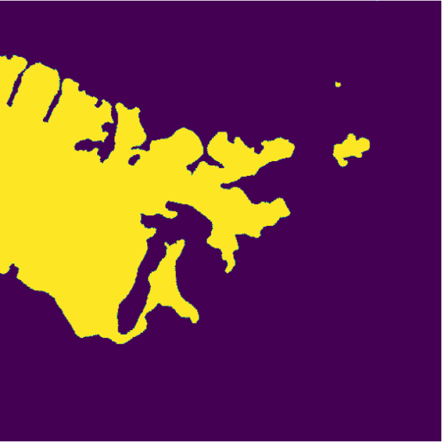
Random data augmentation
Rotation
Notes:
Unique data, regularization

Slide 11
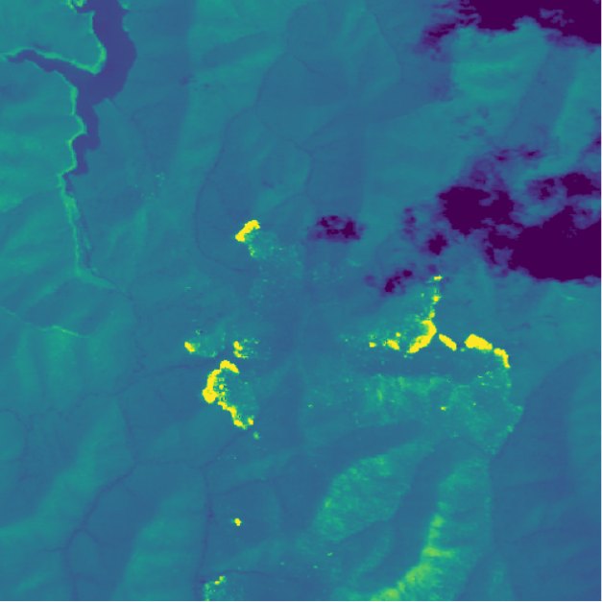
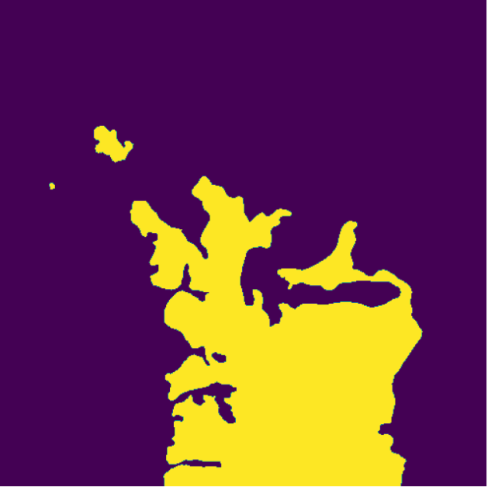
Random data augmentation
H+W Flip
Notes:
Unique data, regularization

Slide 12
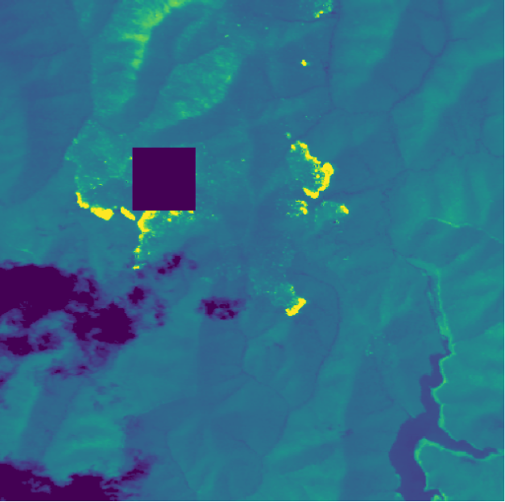
Random data augmentation
Cutout
Notes:
Unique data, regularization

Slide 13

Defining model
U-net
Contracting and expansive paths
Fully convolutional
Customizable number of layers and filters
Source: https://arxiv.org/abs/1505.04597
Notes:
Accepts inputs of different sizes
The contracting path is a typical convolutional network that consists of repeated application of convolutions, each followed by a rectified linear unit (ReLU) and a max pooling operation. During the contraction, the spatial information is reduced while feature information is increased. The expansive pathway combines the feature and spatial information through a sequence of up-convolutions and concatenations with high-resolution features from the contracting path.^{[3]}

Slide 14
Training
Input (image)
Output (mask)
Cross-entropy + Dice loss
Adam with cosine decay
Batch normalization
Loss calculated only from mask center
Notes:
There are also some parameters, most importantly the combination of crossentropy and dice

Slide 15
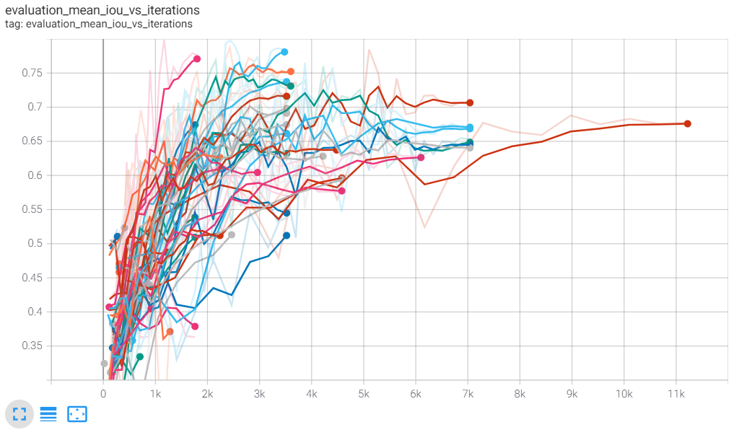
Evaluation
Hyperparameters
Dataset
Augmentation
Input size
Number of filters
Epochs
Dropout
Label smoothing
Notes:
IoU
Noisy
1-2 hours training per experiment

Slide 16
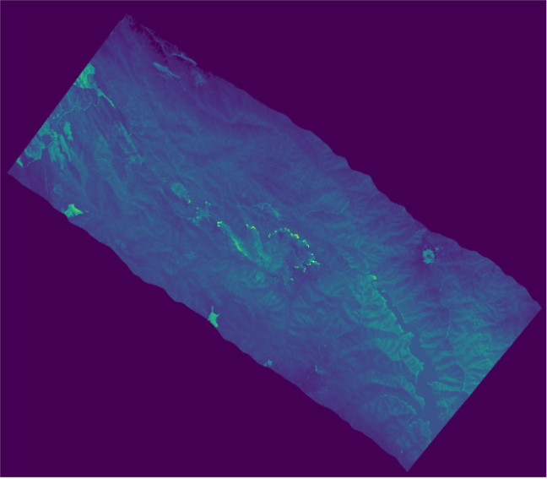
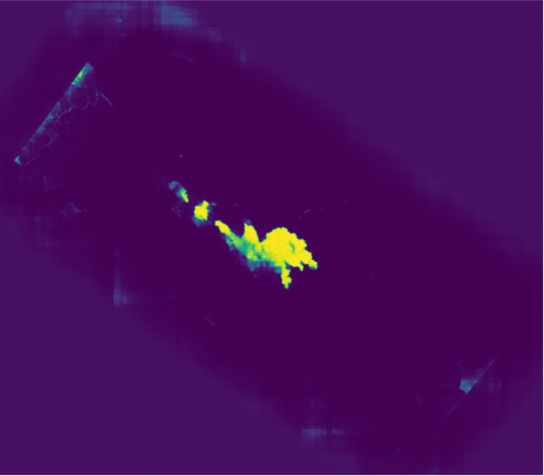
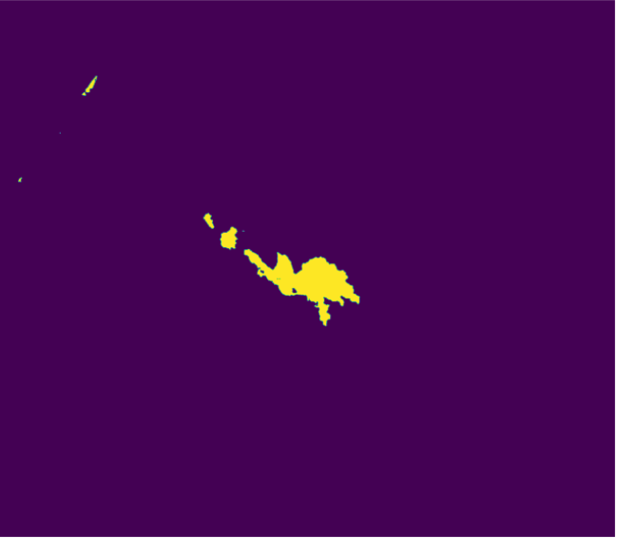
Predictions
Predicting only center of image
Classification threshold
0.5
1024
512
1024
512
U-net
Notes:
90 degrees, averaged

Slide 17
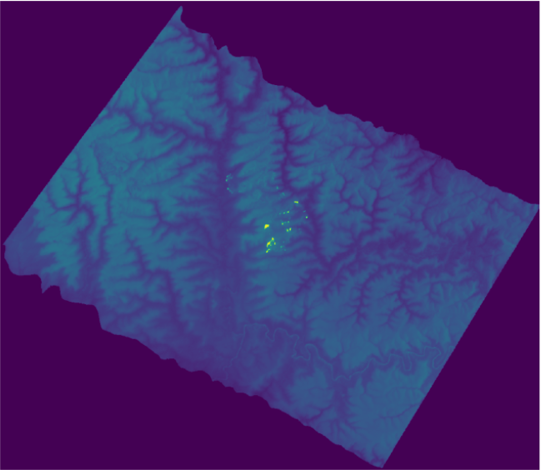
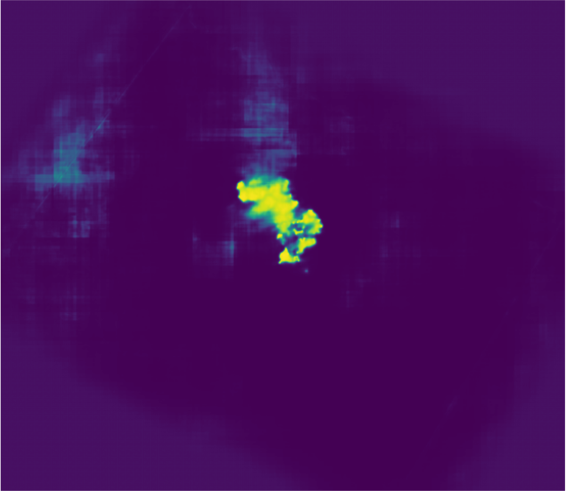
Results
U-net

Slide 18
U-net

Slide 19
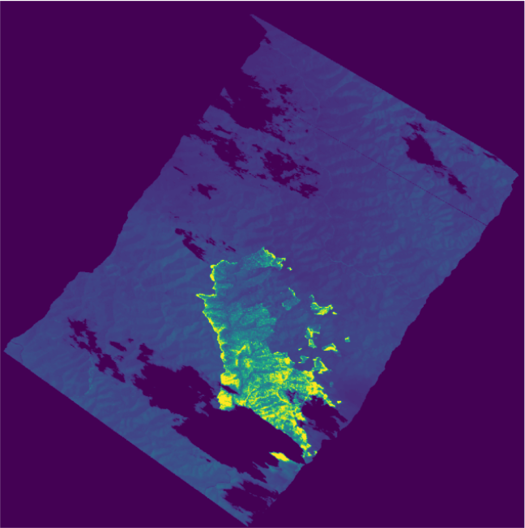
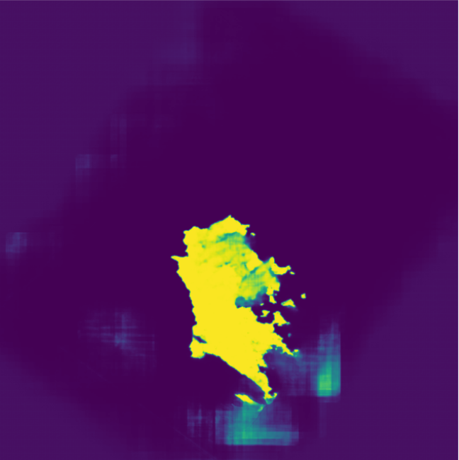
U-net
Clouds

Slide 20
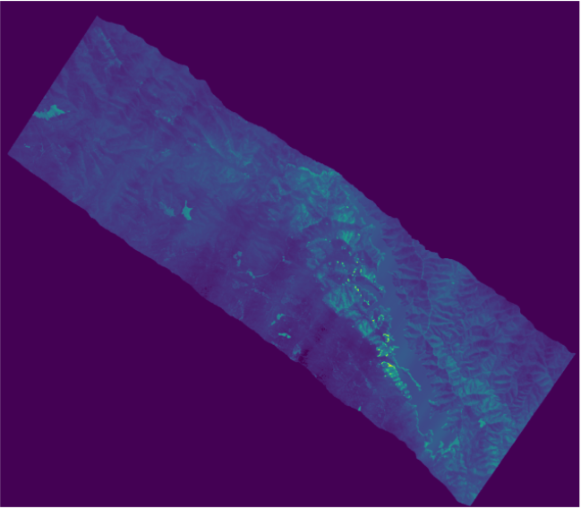
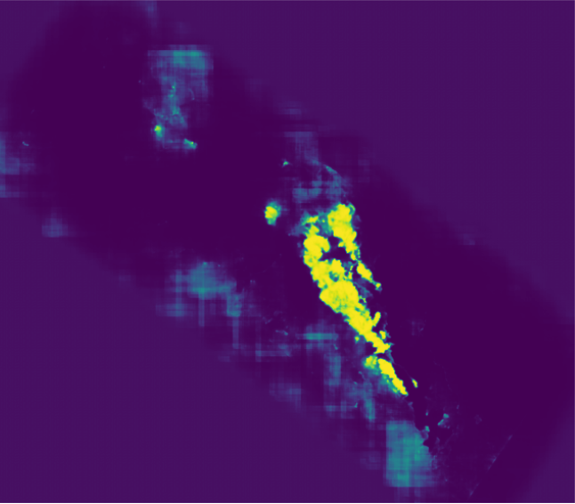
U-net

Slide 21
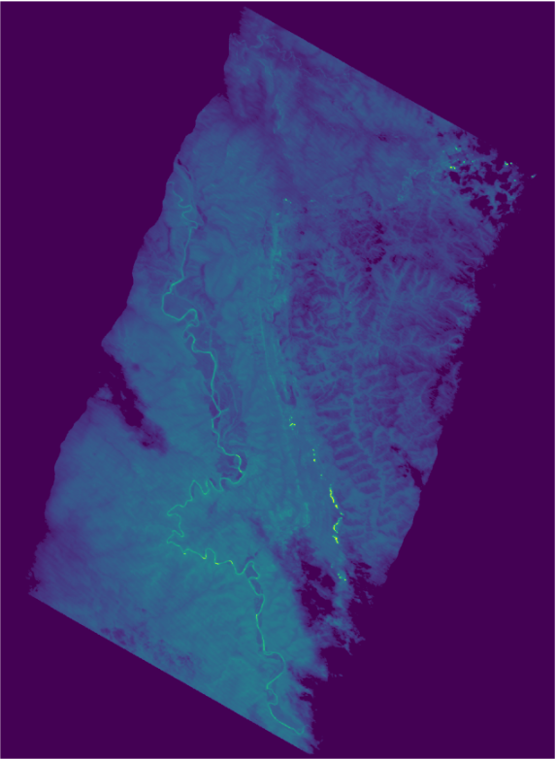
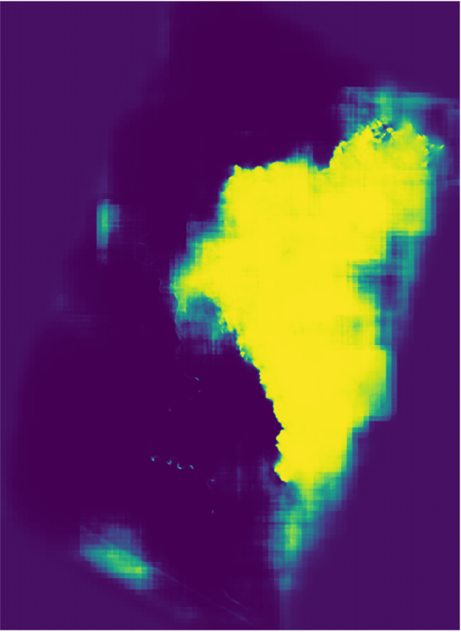
Pixelation
U-net

Slide 22
Why U-net?
Pros
Cons
Quick, parallelizable
Improving with new data
Additional channels
False negatives
Pixelated predictions
Requires threshold

Slide 23
Real-world application?

Slide 24
THANKS!
Dominik Benk
19844055@fsv.cuni.cz

